Slide 1
CBS Semblance workshop #2: Inside the api
MAP - AI & Models
05/05/2021

Slide 2
Agenda
1. CBS API Architecture
2. API project on git lab
3. CI & publishing
4. Routes of CBS API (update/predict)
5. How to perform stress tests
6. Troubleshooting

Slide 3






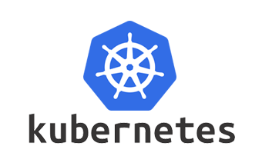


CBS API Architecture
CBS API Architecture
Gitlab project:
datalab/data-science/business-lines/marketing/portugal/cbs/cbs-business
CI/CD
Routes
/action/predict
/action/update
Stress tests
GCP: using virtual machines located in Europe
Python script: Launch n calls to the API and generates a CSV file
Kubernetes namespace
Binary repository
CBS Recommandation API (REST)
Redis
API
STAGING
QA
PRE-PRODUCTION
PRODUCTION
Pod
HTTP requests
CI Orchestrator
User browser
Code source
repository manager
ICP (IBM cloud Private)
Personalization & dynamic
campaign push
Pod
Deployments
Quality gates
Pod
ECS Storage
Data collection
Collect visitor navigation
data from the API and
store raw files on ECS
- Background job
Vertica database
Data collection
Collect visitor navigation
Data from the API and
structure to Vertica
Daily batch
Table: CBS_PORTUGAL_WEB

Slide 4
Useful links
Urls:
Swagger: https://cbs-api-portugal.ngc02.staging.echonet/docs
Gitlab repository: https://git-pfc.rb.echonet/datalab/data-science/business-lines/marketing-central/portugal/cbs/cbs-business
Sonarqube: https://sonar.pico-pfc.dev.echonet/dashboard?id=cbs-api-portugal
IBM Cloud Private: https://cloudngc02.staging.echonet:8443/oidc/login.jsp

